Slide 1
JBOSS EAP 7.3 - Modules, Extensions, Subsystems and Profiles

Slide 2
Modules, Extensions, Subsystems and Profiles
Modules
A module basically provides code (Java Classes) to be used by EAP services and/or by applications. Modules are loaded into an isolated Classloader, and can only see classes from other modules when explicitly requested
Extensions
Extension is the reference of a module in .xml configuration files.
SubSystems
Most modules include a configurable element called a subsystem. Subsystem configuration information is stored in the unified configuration file EAP_HOME/domain/configuration/domain.xml for a managed domain or EAP_HOME/standalone/configuration/standalone.xml for a standalone server.
Each subsystem's configuration is defined in an XML schema. The configuration schemas are located in the EAP_HOME/docs/schema/ directory of your installation.
Profile
A profile is a group of subsystems configurations

Slide 3
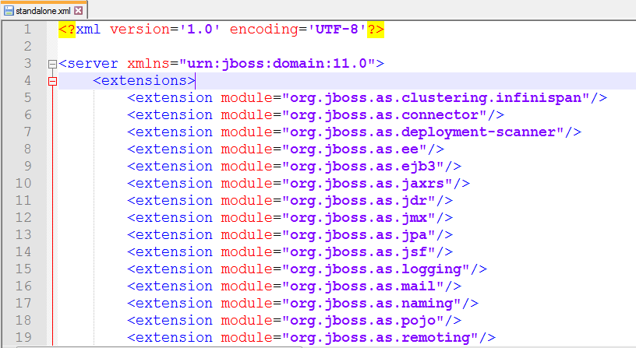
Example of Extensions

Slide 4
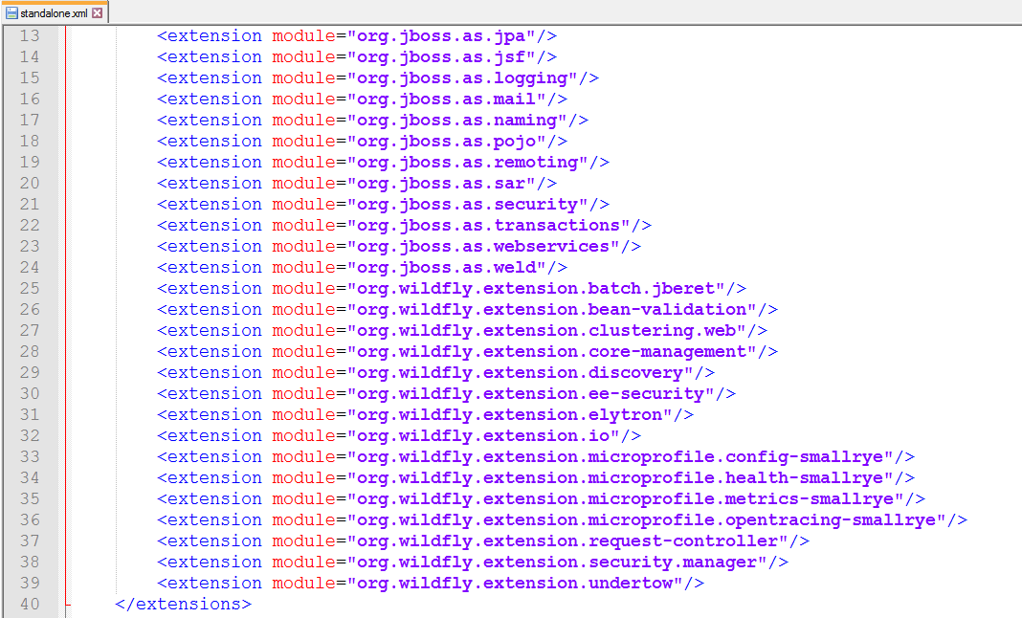

Slide 5
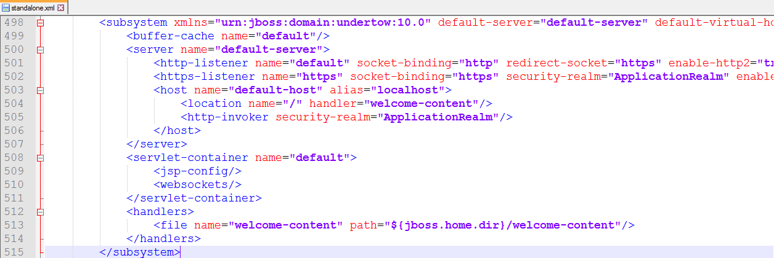
Example: undertow subsystem
In JBoss EAP 7.3, the undertow subsystem takes the place of the webserver subsystem from previous versions of JBoss EAP.
The undertow subsystem allows you to configure the web server and servlet container settings.

Slide 6
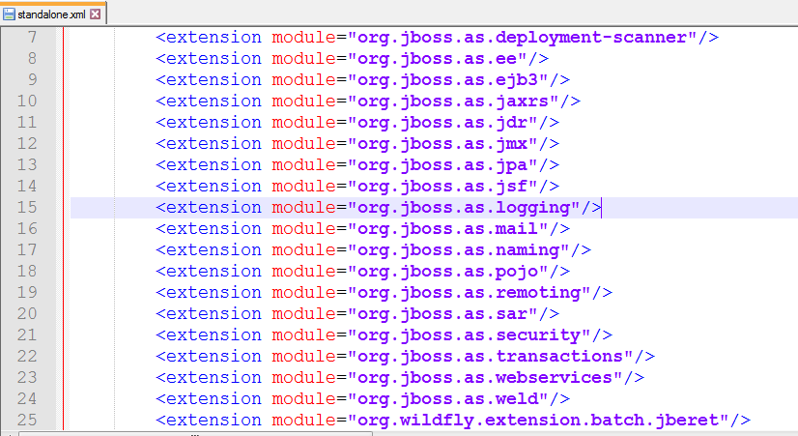
Example: Logging module

Slide 7
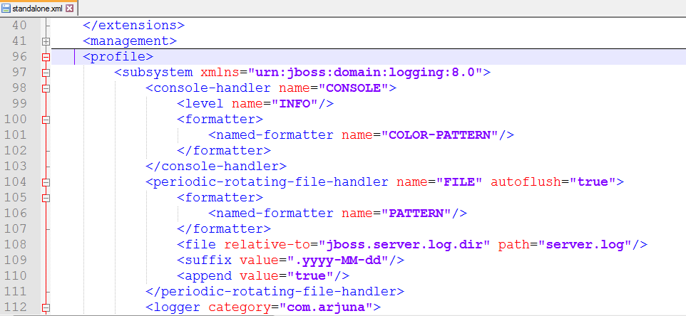
Logging Subsystem

Slide 8
Extension module name | Description
org.jboss.as.ee | Bean validation,Component,Naming,EEApplcation,DataSource related EAR deployment related
org.jboss.as.ejb3 | EJB3 java bean related
org.jboss.as.jaxrs | Restful java web services related
org.jboss.as.jdr | JBoss Diagnostic Reporter JDR collects the following items: configuration files log files deployment information runtime information
org.jboss.as.jmx | The JMX Console is a web console for monitoring Java message transactions.
org.jboss.as.transactions | JBoss Transactions (JBoss TS) is the new default transaction manager for JBoss

Slide 9
Extension module name | Description
org.jboss.as.jpa | Java Persistence API (JPA),
org.jboss.as.jsf | JavaServer Faces (JSF) is a Java specification for building component-based user interfaces for web applications
org.jboss.as.jsr77 | Java specification request (JSR-77) is a J2ee management specification for standardization of J2EE server management
org.jboss.as.mail | configure email session in JBoss
org.jboss.as.naming | provides a naming service that allows a user to map a name onto an object
org.jboss.as.sar | SAR file is created with the .sar extenstion, used for writing thread related components which has to be running independently.
org.jboss.as.security | Provides the security related features implemented via roles access etc

Slide 10
Extension module name | Description
org.jboss.as.pojo | POJO stands for Plain Old Java Object. POJOs are used for increasing the readability and re-usability of a program.
org.jboss.as.remoting | JBossRemoting is a enables you to very easily design, implement, and deploy services that can be remotely invoked by clients using several different transport mechanisms transparently
org.wildfly.extension.undertow | Undertow is a flexible performant web server written in java
org.wildfly.extension.elytron | The WildFly Elytron project is a new security framework
org.wildfly.extension.request-controller | The request controller subsystem. Used for request limiting and graceful shutdown

